Slide 1
PYGG POT
Subject: HCI
Semester VI
By: Rhea Acharya (B002) and Harshitha (B053)
2018-19

Slide 2
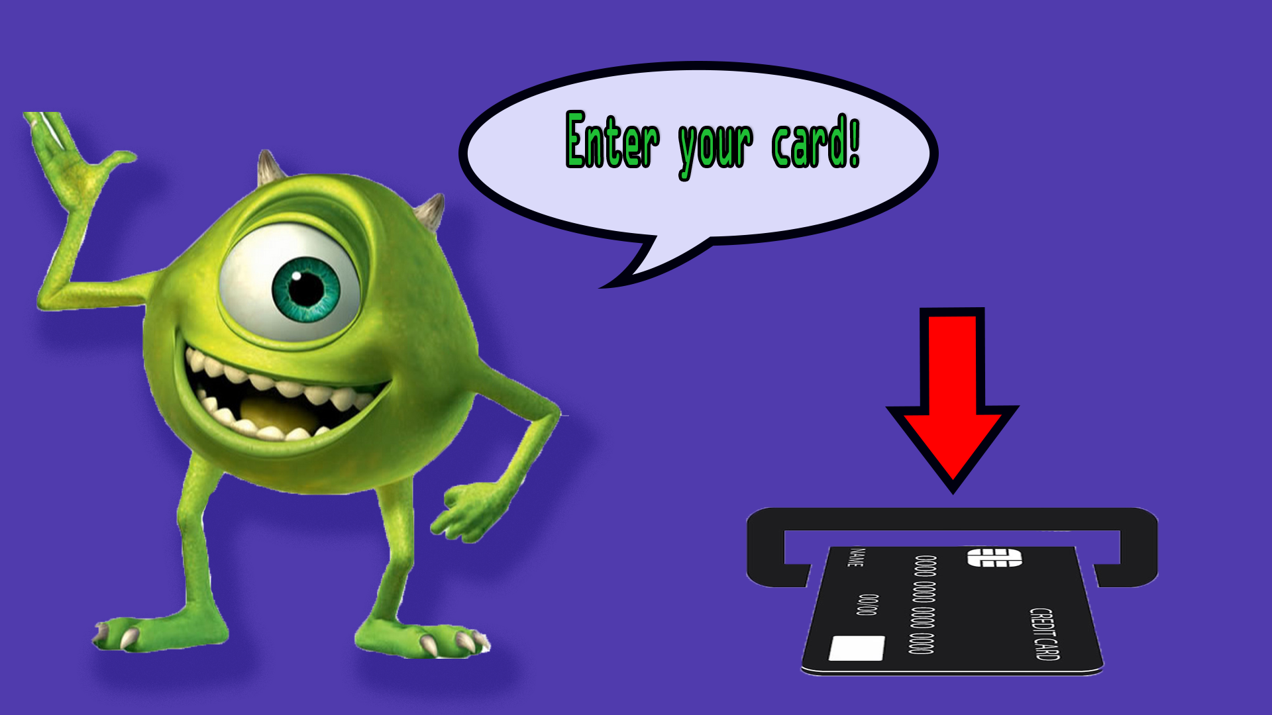


Slide 3
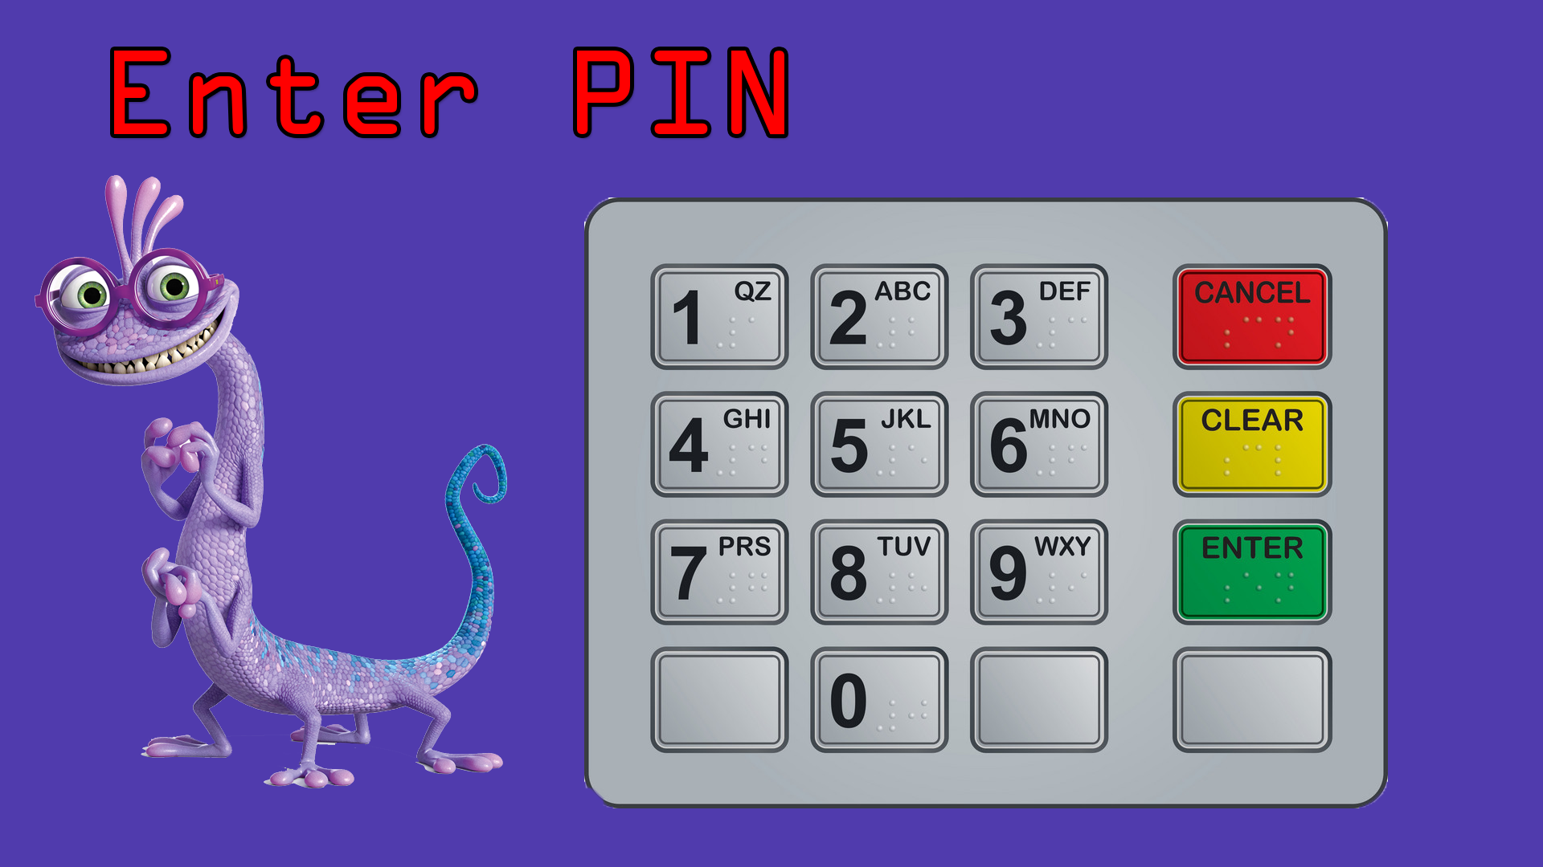
* * * *
FINGER SCAN

Slide 4

RETRY

Slide 5

Place your finger below
and say your Name:

Slide 6


Slide 7


Slide 8


Slide 9

NEXT

Slide 10
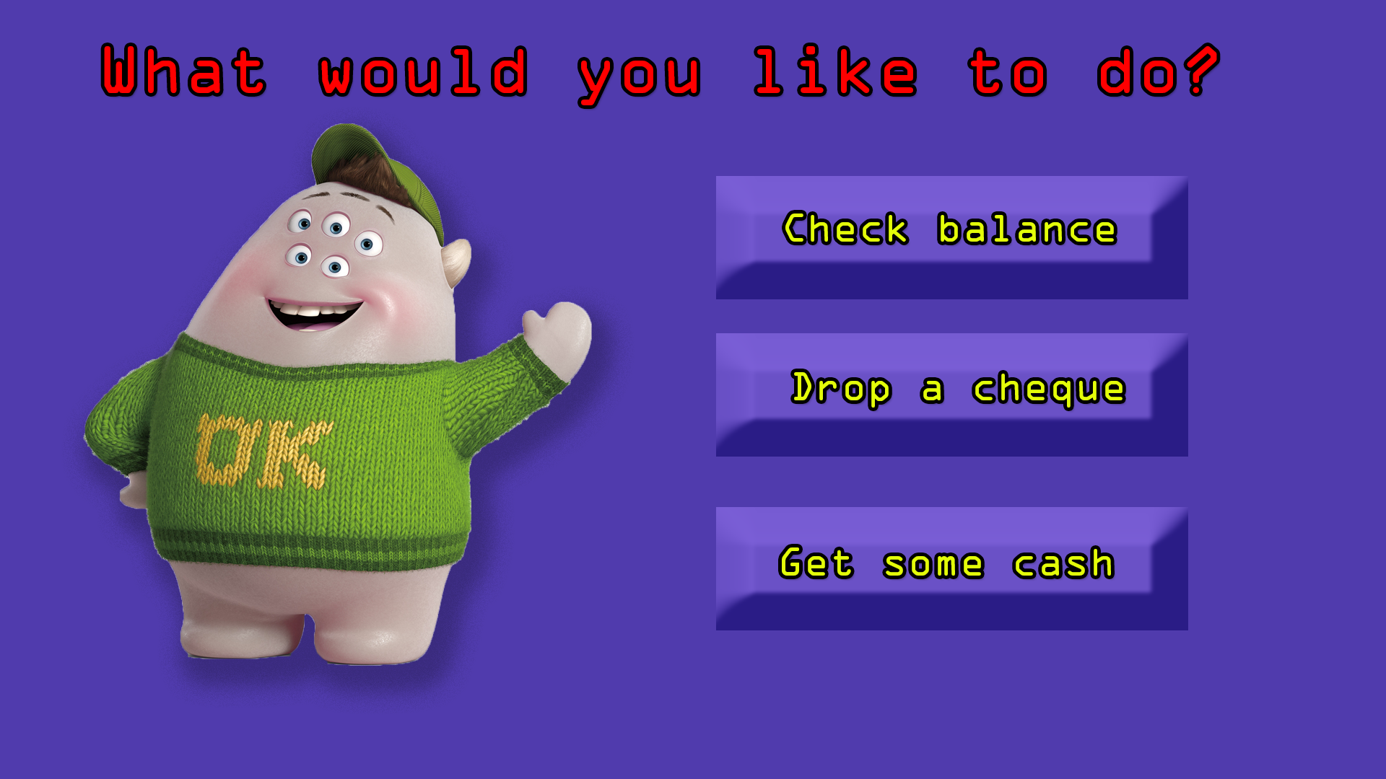

Slide 12

OK!

Slide 14
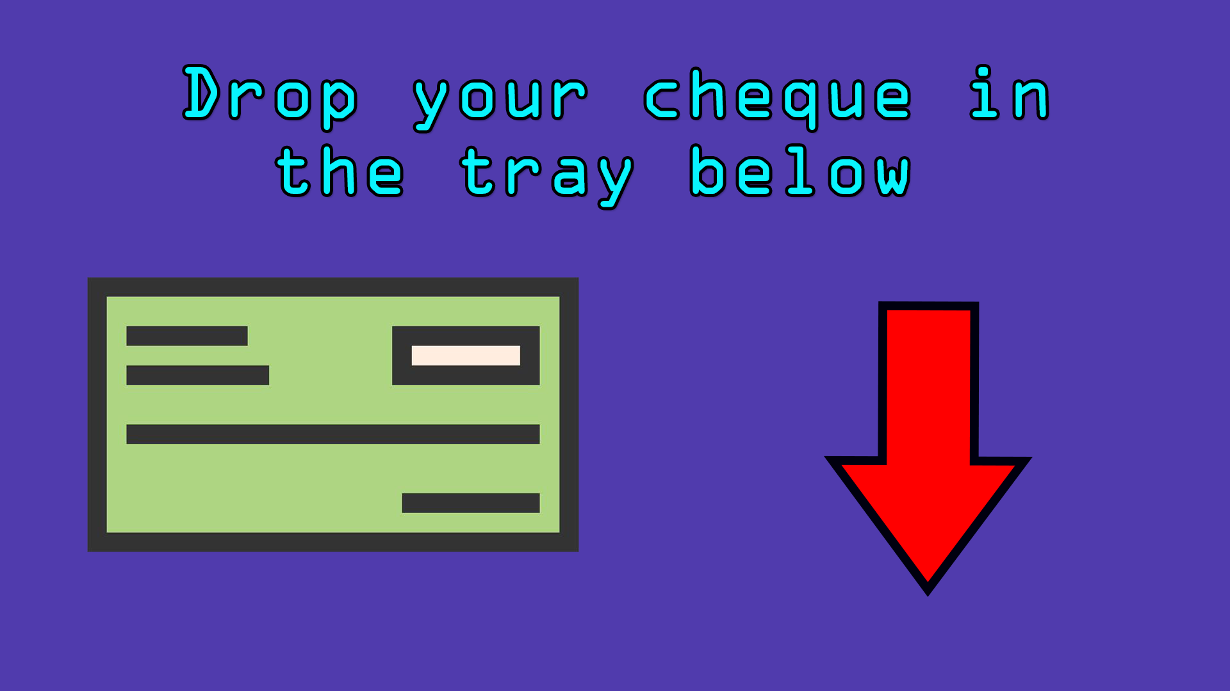
DONE

Slide 16
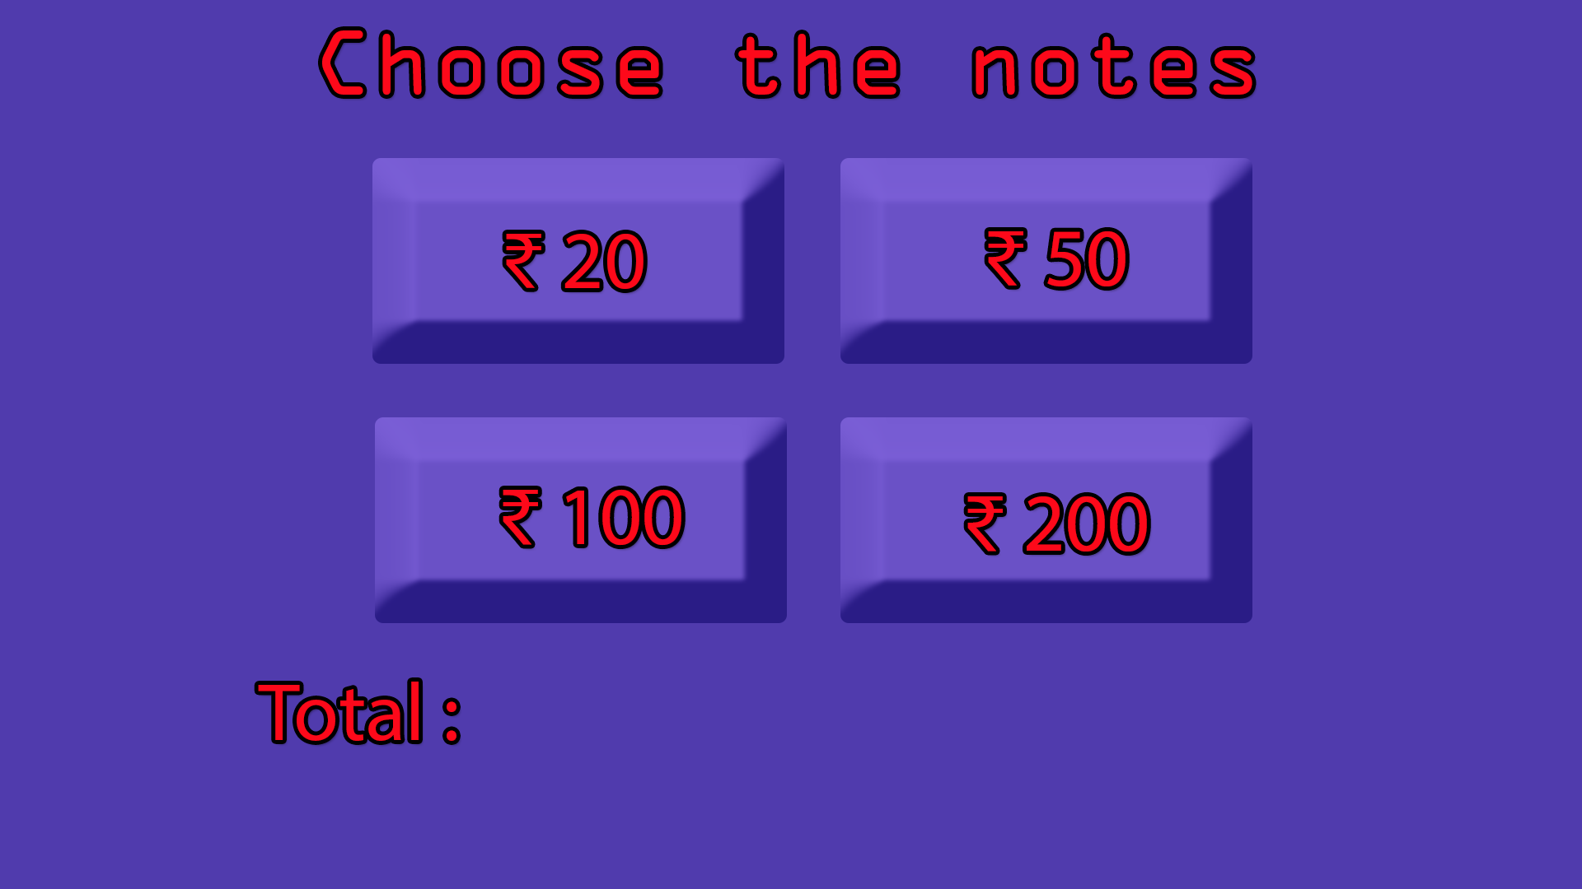
Rs. 20
GO!

Slide 17
Rs. 520
GO!

Slide 18

RE-ENTER

Slide 19
Rs. 220
GO!

Slide 20

COLLECTED!

Slide 21

DONE!

Slide 22
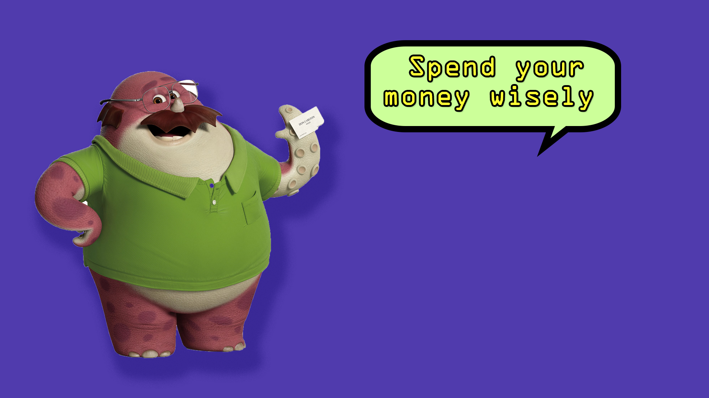

Slide 24
